Slide 1
Availability Bias on Line Transect Surveys

Slide 2
Availability is a kind of heterogeneity
Animals that become available more often are more likely to be detected.
Animals that become available closer to observers are more likely to be detected.

Slide 3
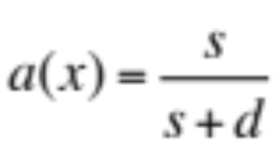
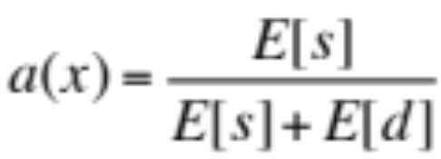
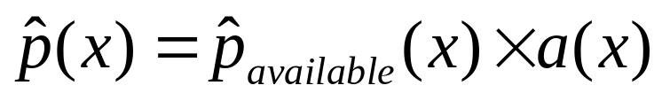
Simple Correction Factor
Prob(animal is available)=a
The Problem
(1) Availability Bias
Observer
x
W

Slide 4
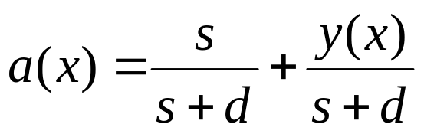
… But animals at small x have longer to be available
Prob(animal at x is available at least once)=a(x)
For “small” y(x):
The Problem
(1) Availability Bias
(McLaren, 1961)
y(x)
Observer
x
W

Slide 5
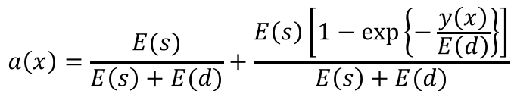
… But McLaren’s a(x) can be greater than 1
Prob(animal at x is available at least once)=a(x)
For any y(x):
The Problem
(1) Availability Bias
(Laake et al., 1997)
y(x)
Observer
x
W

Slide 6
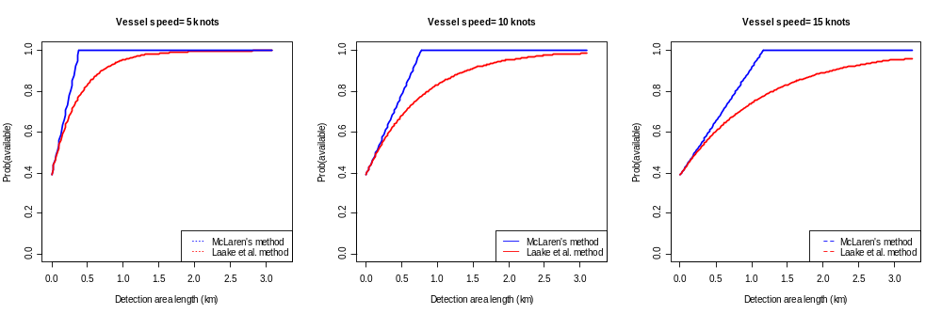
McLaren’s vs Laake’s Method

Slide 7
… But an animal available at big y is less detectable than an animal available at small y
… which means we should model detection probability as a function of x and y.
The Problem
(1) Availability Bias
y(x)
Observer
x
W

Slide 8
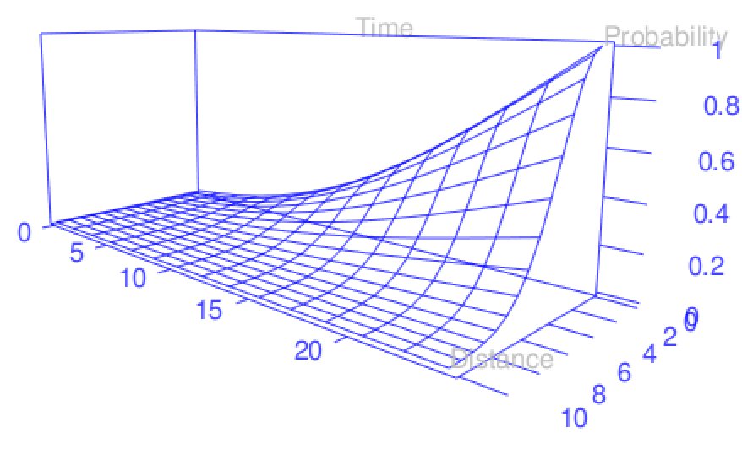

Distance Sampling is really 2-dimensional
The detection hazard p(x,y)
Forward distance (y)
The detection function, p(x)

Slide 9
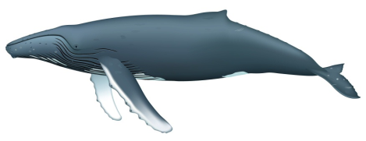
Hidden Markov Model for Availability
Detection hazard at x,
given availability: h(x,y)
. . . . . . . . .
Time
1
2
t
y_{t}
0
T

Slide 10
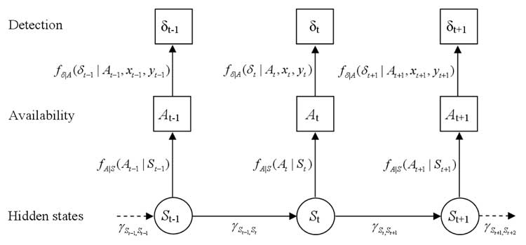
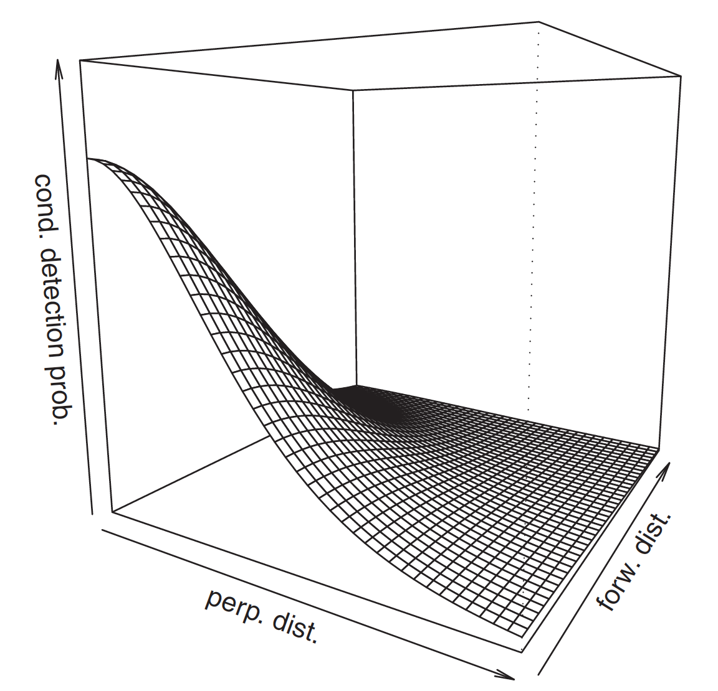
Hidden Markov Model for Estimator
Specify a form for the 2-dimensional detection hazard h(x,y)
B(h(x,y_{t-1}))
B(h(A_{t-1},x,y_{t-1}))
B(h(x,y_{t}))
B(h(x,y_{t+1}))
B(λ_{St-1})
B(λ_{St})
B(λ_{St+1})

Slide 11
Hidden Markov Model for Estimator
Specify a form for the 2-dimensional detection hazard h(x,y)
B(h(x,y_{t-1}))
B(h(A_{t-1},x,y_{t-1}))
B(h(x,y_{t}))
B(h(x,y_{t+1}))
B(λ_{St-1})
B(λ_{St})
B(λ_{St+1})
Special case: 2-states, one of which is available, the other unavailable.
This is model used by Laake et al. – but this correction factor is Prob(available at least once | x=0), which is not = Prob(see | x=0).
Specify availability parameters:
(1) State transition probabilities: γs
(2) Probability available given states
Can specify simply by giving mean times available and unavailable in a single availability cycle.

Slide 12
When there is availability bias
McLaren’s method just a poorer version of Laake’s method.
Laake’s, McLaren’s and similar methods potentially substantially biased. OK when animals in view for short time relative to availability cycle length.
Cue-counting an option. Not animal-based
Alternatively, model p(x,y) and availability (animal-based):
  Borchers, Zucchini, Heide-Jorgensen & Canadas. Hidden Markov models to deal with availability bias on line transect surveys. Bometrics 69:703-713.
  Langrock, Borchers & Skaug. Markov-modulated nonhomogeneous Poisson processes for unbiased estimation of marine mammal abundance. Journal of the American Statistical Association 108: 840-851.
  Borchers, D.L. and Langrock, R. 2015. Double-Observer Line Transect Surveys with Markov-Modulated Poisson Process Models for Overdispersed Animal Availability. Biometrics 71: 1060–1069.

Slide 13
Summary
When time in view very small relative to availability cycle, simple correction methods work OK – otherwise they do not.
HMM (or MMPP) method better, but needs forward distances (so collect them – it is often not difficult).
  In simplest case, HMM method needs no more data than Laake’s method.
  More general (generally better) case needs a HMM to have been fitted to availability time series data.
R package hmltm implements HMM method

